Slide 1


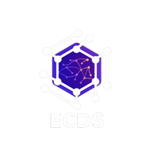


ECDS
PREDICTIVE EQUIPMENT MAINTENANCE
AGENT (MRI/CT)
TEAM 404

Slide 2
ECDS
GUIDELINES
GitHub Submission: Submit your GitHub repository 8 hours before final evaluation.
Deployment: Deploy the complete project repository (frontend deployment optional).
Plagiarism Check: All submissions will undergo plagiarism verification.
Pitch Format: Round 1 & Round 2 will include a 7-minute project pitch + evaluation.
Team Requirement: Minimum 3 team members must be present during evaluation.

Slide 3
ECDS
PROBLEM STATEMENT
Hospitals rely on critical imaging equipment such as MRI and CT scanners to perform many patient scans daily. Unexpected failures can disrupt hospital operations, delay diagnoses, and cause significant financial losses. However, current maintenance methods are mostly reactive or schedule-based, ignoring early warning signals in telemetry data like temperature changes, pressure drops, and error codes. As a result, issues are often detected only after a breakdown occurs. This highlights the need for an AI-driven predictive maintenance system that monitors machine telemetry, detects anomalies early, and enables proactive maintenance to ensure maximum uptime and uninterrupted patient care.

Slide 4
ECDS
SOLUTION
AI-driven Predictive Equipment Maintenance Agent that continuously monitors telemetry data from MRI and CT machines, including parameters such as temperature, helium pressure, vibration, error codes, and scan usage. The system analyzes this data using anomaly detection and time-series pattern analysis to identify early signs of potential equipment failures. Based on the detected risk level, the agent can automatically recommend preventive maintenance, notify engineering teams, and intelligently reschedule affected patient appointments to minimize disruption. Additionally, the system introduces innovative features such as Eco-Mode energy optimization, which reduces power consumption during idle periods, and an Intelligent Limp Mode, allowing restricted machine operation for low-intensity scans instead of complete shutdown, thereby improving machine uptime, reducing operational costs, and ensuring continuous patient care

Slide 5
ECDS
INNOVATION & USP
AI-Driven Predictive Maintenance:
Continuously monitors MRI/CT telemetry such as temperature, helium pressure, vibration, and error codes.
Uses time-series anomaly detection to identify early failure signatures before breakdown.
Predicts failure risk levels (Normal, Monitor, Maintenance Required, Critical) and recommends preventive maintenance.
Intelligent “Limp Mode” :
Adaptive Workload Control Introduces a Restricted Operation Mode instead of complete machine shutdown.The system analyzes the type of detected fault and determines which scans can still run safely.
Example: If a gradient coil overheats, high-power body scans are restricted while low-power head scans continue, maintaining partial service availability.
Eco-Mode & Smart Energy Optimization
Detects idle gaps in the patient schedule automatically. Switches MRI machines to Eco-Standby / Deep Sleep mode during idle periods.Automatically wakes the machine before the next scan, reducing energy waste while maintaining readiness.

Slide 6
ECDS
Autonomous Hospital Workflow Optimization:
Automatically schedules maintenance with service vendors during optimal time windows. Reschedules patient appointments intelligently to minimize disruption. Provides cost impact analysis comparing preventive maintenance vs equipment breakdown.
Real-Time Decision Support Dashboard:
Displays machine health status, anomaly alerts, predicted failures, and maintenance recommendations. Shows energy savings and operational insights in real time.Helps hospital engineering teams make faster, data-driven decisions.

Slide 7
ECDS
USP
“Our system transforms hospital equipment maintenance from reactive repair to intelligent, energy-efficient, and patient-centric predictive operations.”

Slide 8
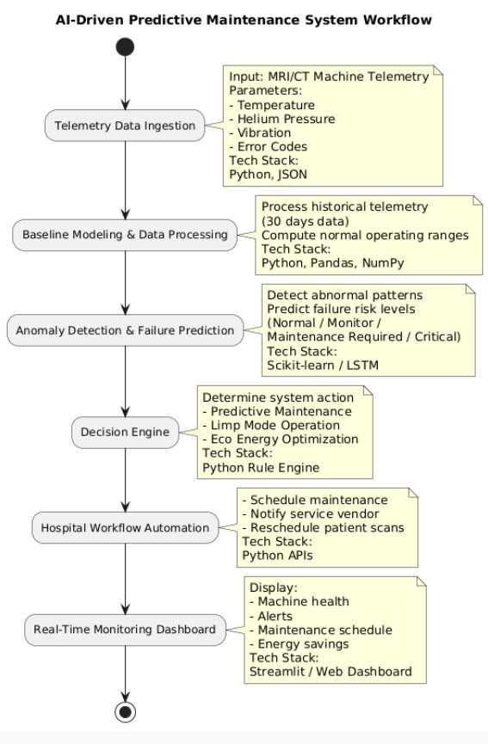
ECDS
WORKFLOW DIAGRAM WITH TECH STACK

Slide 9
ECDS
TEAM MEMBERS
22MIS1103 – Manoj Sagaran A
22MIS1115 – Azim Niyaz
22MIS1018 – Tharun Kumar
22MIS1156 – Giridharan S
22MIS1087 – Giridharaeswaran S
22MMIS1219 – Tejeswar

